Slide 1
Chapter 7: Transport Layer
Introduction to Networking
Notes:
Cisco Networking Academy program
Introduction to Networking
Chapter 7

Slide 2
Chapter 7
7.0 Introduction
7.1 Transport Layer Protocols
7.2 TCP and UDP
7.3 Summary
Notes:
Chapter 7

Slide 3
Chapter 7: Objectives
Describe the purpose of the transport layer in managing the transportation of data in end-to-end communication.
Describe characteristics of the TCP and UDP protocols, including port numbers and their uses.
Explain how TCP session establishment and termination processes facilitate reliable communication.
Explain how TCP protocol data units are transmitted and acknowledged to guarantee delivery.
Explain the UDP client processes to establish communication with a server.
Determine whether high-reliability TCP transmissions, or non-guaranteed UDP transmissions, are best suited for common applications.

Slide 4
7.1: Transport Layer Protocols
Notes:
7.1 Transport Layer Protocols

Slide 5
Transportation of Data Role of the Transport Layer
The transport layer is responsible for establishing a temporary communication session between two applications and delivering data between them.
TCP/IP uses two protocols to achieve this:
Transmission Control Protocol (TCP)
User Datagram Protocol (UDP)
Primary Responsibilities of Transport Layer Protocols
Tracking the individual communication between applications on the source and destination hosts
Segmenting data for manageability and reassembling segmented data into streams of application data at the destination
Identifying the proper application for each communication stream
Notes:
7.1.1.1 and 7.1.1.2 Role of the Transport Layer

Slide 6
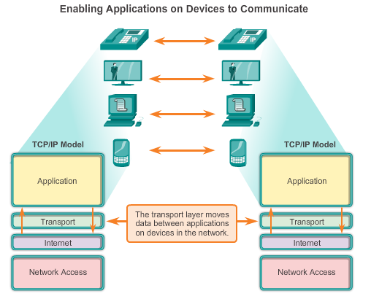
Transportation of Data Role of the Transport Layer (Cont.)
Notes:
7.1.1.2 Role of the Transport Layer (Cont.)

Slide 7
Transportation of Data Conversation Multiplexing
Segmenting the Data
Enables many different communications, from many different users, to be interleaved (multiplexed) on the same network, at the same time.
Provides the means to both send and receive data when running multiple applications.
Header added to each segment to identify it.
Notes:
7.1.1.3 Conversation Multiplexing

Slide 8
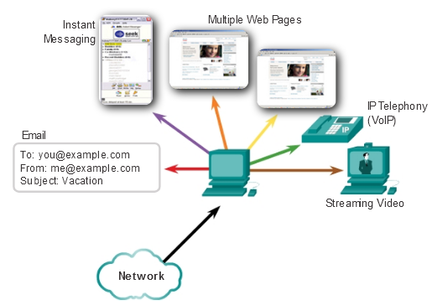
Tracking the conversation
The transport layer tracks each individual conversation flowing between a source application and a destination application separately.

Slide 9
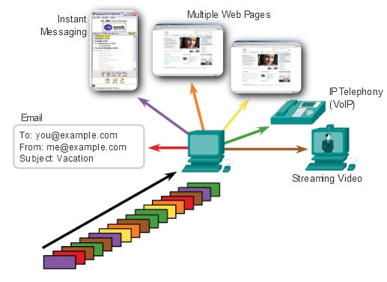
Segmentation
The transport layer divides the data into segments that are easier to manage and transport

Slide 10
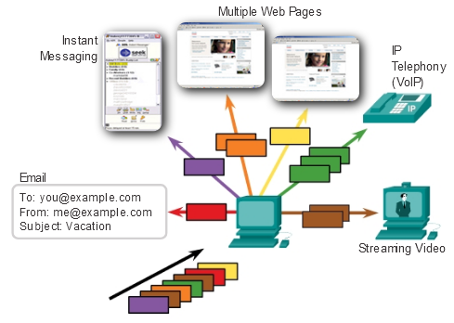
Identifying the Application
The transport layer ensures that even with multiple applications running on a device, all applications receive the correct data

Slide 11
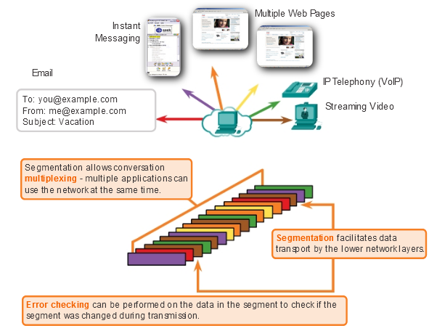
Transport Layer Services

Slide 12
Transportation of Data Transport Layer Reliability
Different applications have different transport reliability requirements.
TCP/IP provides two transport layer protocols, TCP and UDP.
TCP
Provides reliable delivery ensuring that all of the data arrives at the destination.
Uses acknowledged delivery and other processes to ensure delivery
Makes larger demands on the network – more overhead.
UDP
Provides just the basic functions for delivery – no reliability.
Less overhead.
TCP or UDP
There is a trade-off between the value of reliability and the burden it places on the network.
Application developers choose the transport protocol based on the requirements of their applications.
Notes:
7.1.1.4 Transport Layer Reliability
7.1.1.5 TCP
7.1.1.6 UDP
7.1.1.7 The Right Transport Layer Protocol for the Right Application

Slide 13
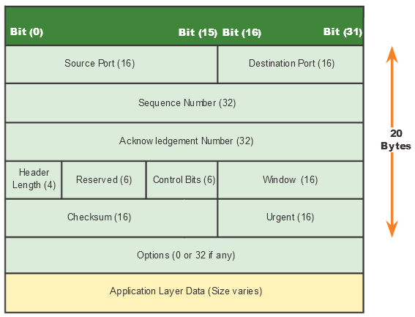
Introducing TCP and UDP Introducing TCP
Defined in RFC 793
Connection-oriented – Creates a session between the source and destination
Reliable delivery – Retransmits lost or corrupt data
Ordered data reconstruction – Reconstructs numbering and sequencing of segments
Flow control – Regulates the amount of data transmitted
Stateful protocol – Tracks the session
Notes:
7.1.2.1 Introducing TCP
7.1.2.2 Role of TCP

Slide 14
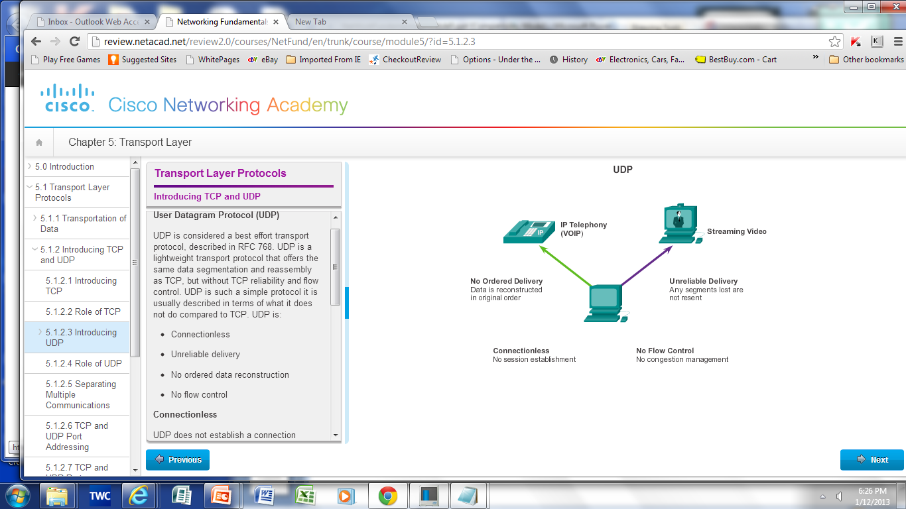
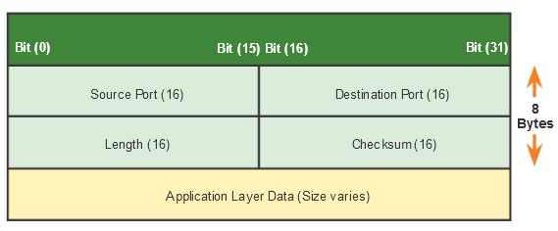
Introducing TCP and UDP Introducing UDP
RFC 768
Connectionless
Unreliable delivery
No ordered data reconstruction
No flow control
Stateless protocol
Applications that use UDP:
Domain Name System (DNS)
Video Streaming
VoIP
Notes:
7.1.2.3 Introducing UDP
7.1.2.4 Role of UDP

Slide 15
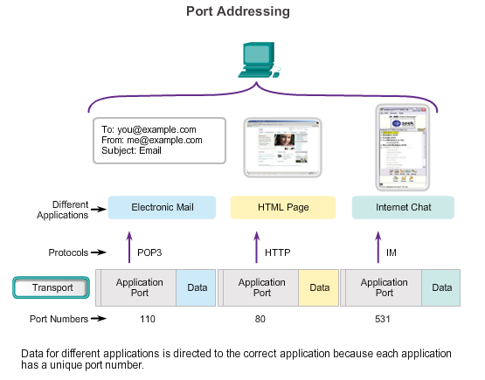
Introducing TCP and UDP Separating Multiple Communications
TCP and UDP use port numbers to differentiate between applications.
.
Notes:
7.1.2.5 Separating Multiple Communications
7.1.2.6 TCP and UDP Port addressing

Slide 16
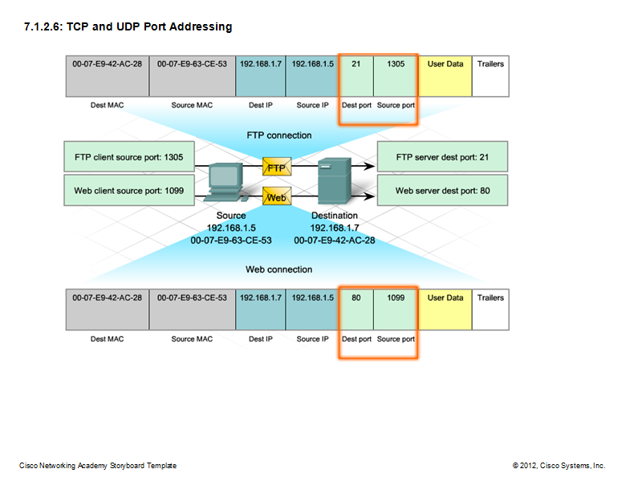
Introducing TCP and UDP TCP and UDP Port Addressing
Notes:
7.1.2.7 TCP and UDP Port Addressing (Cont.)

Slide 17
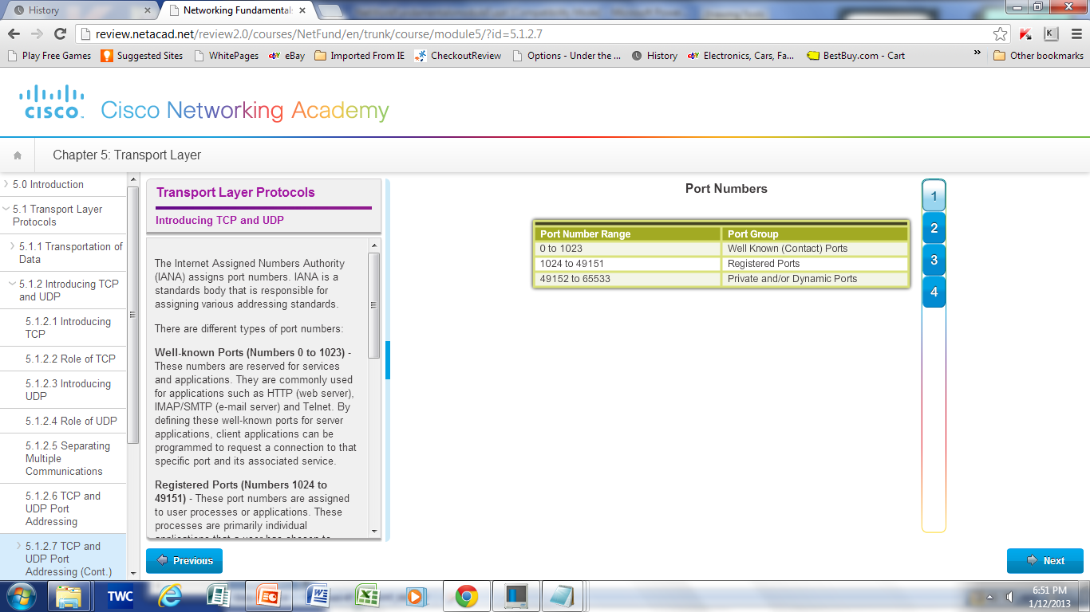
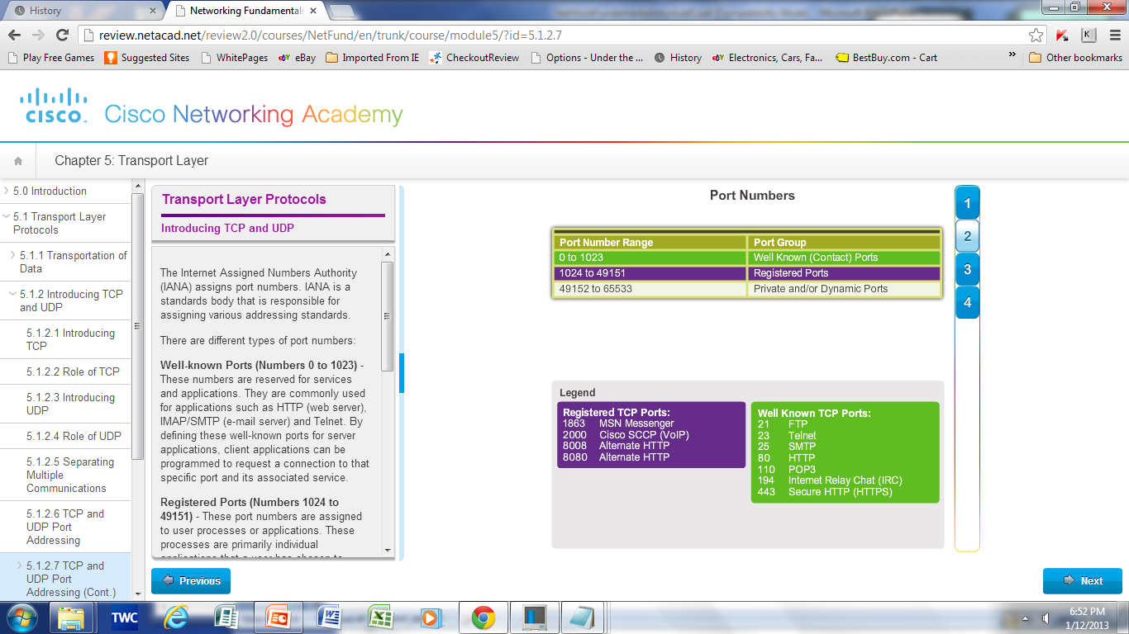
Introducing TCP and UDP TCP and UDP Port Addressing (Cont.)
Notes:
7.1.2.8 TCP and UDP Port Addressing (cont)

Slide 18
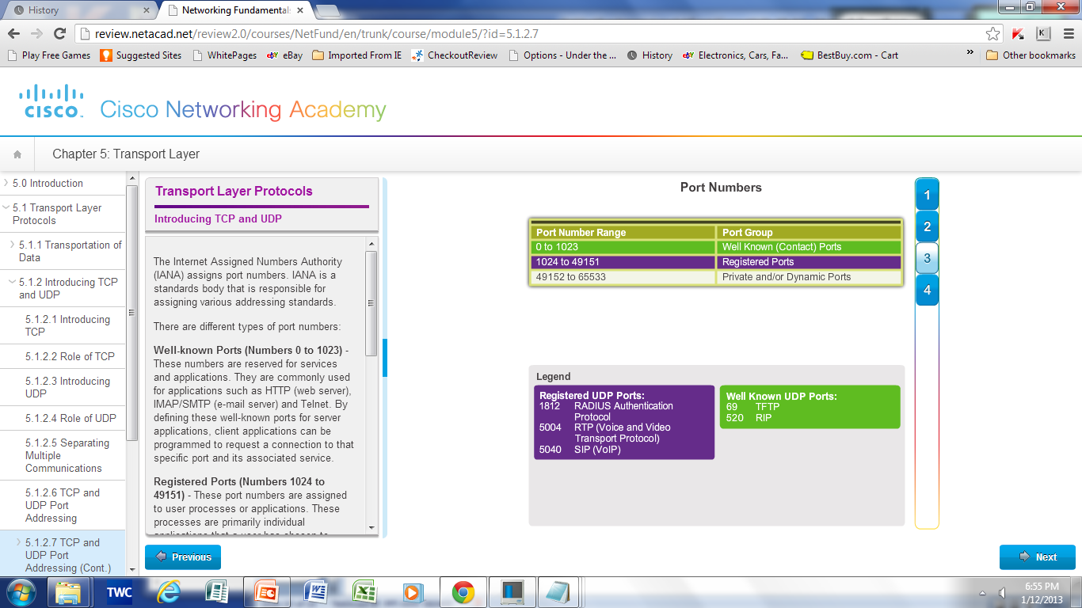
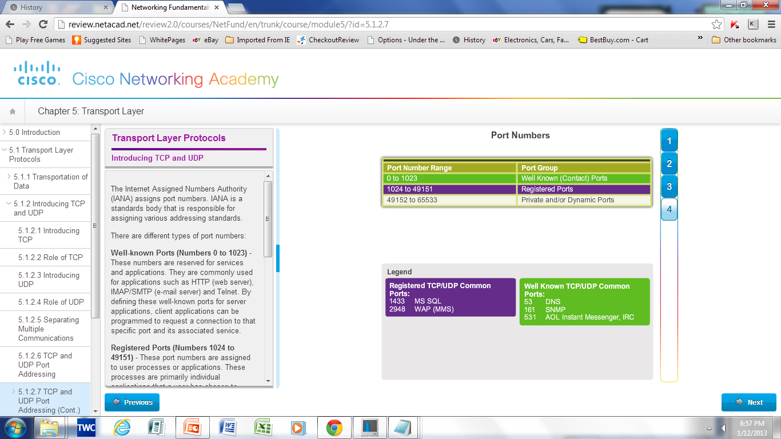
Introducing TCP and UDP TCP and UDP Port Addressing (Cont.)
Notes:
7.1.2.8 TCP and UDP Port Addressing (cont)

Slide 19
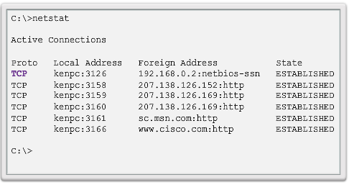
Introducing TCP and UDP TCP and UDP Port Addressing (Cont.)
Netstat is used to examine TCP connections that are open and running on a networked host.
Notes:
7.1.2.9 TCP and UDP Port Addressing (cont)

Slide 20
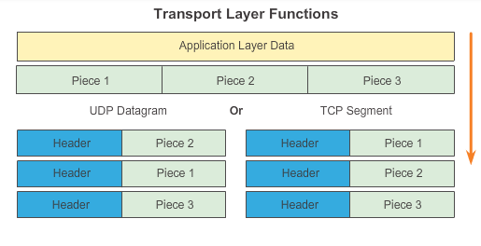
Introducing TCP and UDP TCP and UDP Segmentation
The transport layer divides the data into pieces and adds a header for delivery over the network
Notes:
7.1.2.10 TCP and UDP Segmentation

Slide 21
7.2 TCP and UDP
Notes:
7.2 TCP and UDP

Slide 22
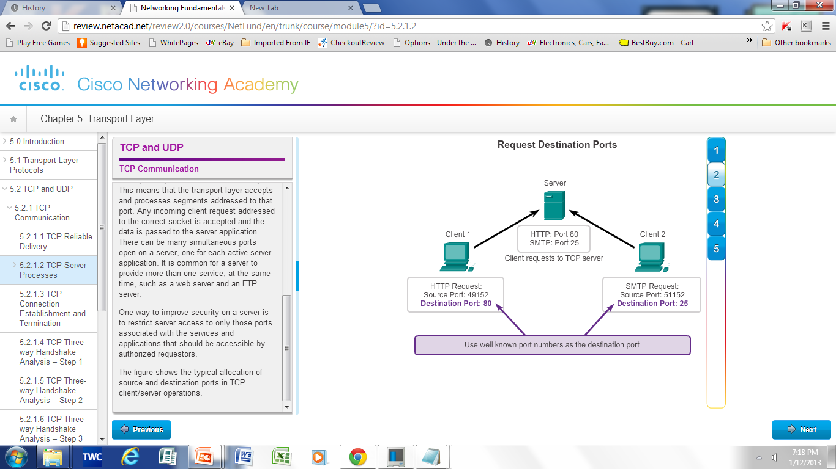
TCP Communication TCP Server Processes
Notes:
7.2.1.2 TCP Server Processes

Slide 23
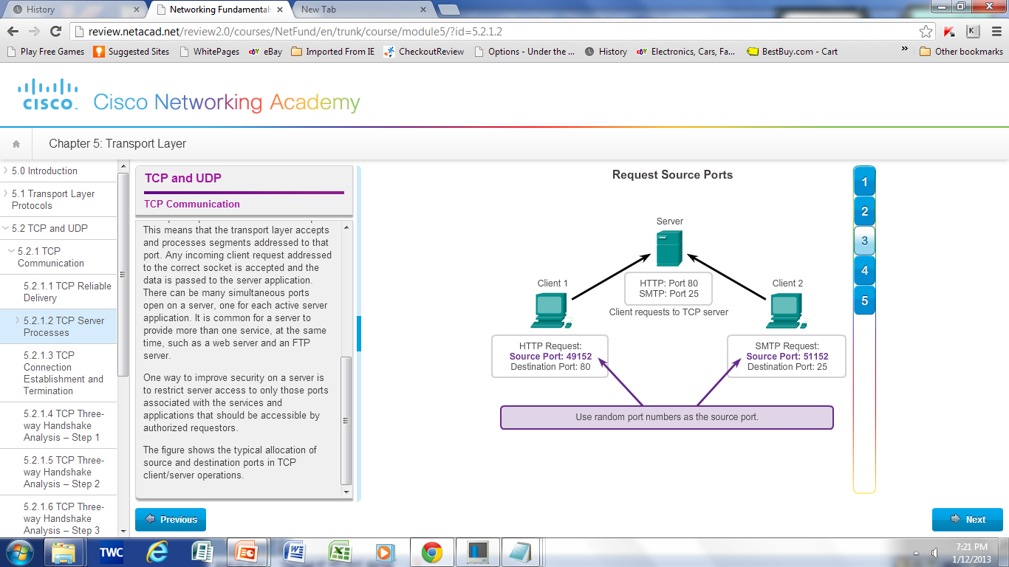
TCP Communication TCP Server Processes (Cont.)
Notes:
7.2.1.2 TCP Server Processes

Slide 24
TCP Communication TCP Connection, Establishment and Termination
Three-Way Handshake
Establishes that the destination device is present on the network
Verifies that the destination device has an active service and is accepting requests on the destination port number that the initiating client intends to use for the session
Informs the destination device that the source client intends to establish a communication session on that port number
Notes:
7.2.1.3 TCP Connection, Establishment and Termination

Slide 25
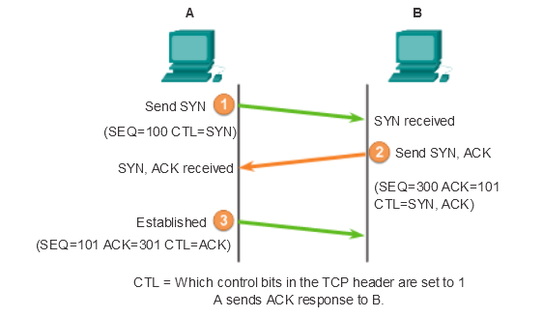
Three-Way Handshake

Slide 26
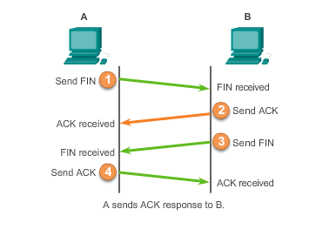
TCP Communication TCP Session Termination
Check Activity 7.2.1.9 in CCNA
Notes:
7.2.1.7 TCP Session Termination

Slide 27
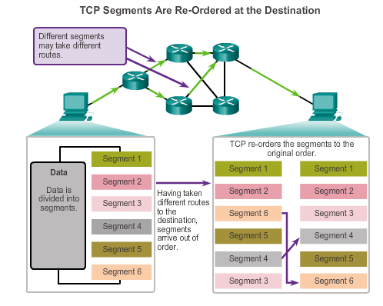
Reliability and Flow Control TCP Reliability – Ordered Delivery
Sequence numbers are used to reassemble segments into their original order.
Notes:
7.2.2.1 TCP Reliability – Ordered Delivery

Slide 28
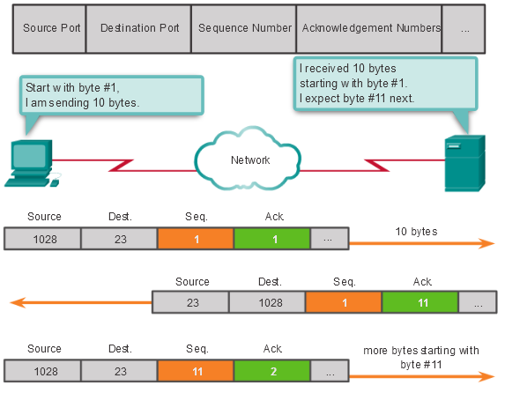
Reliability and Flow Control Acknowledgement and Window Size
The sequence number and acknowledgement number are used together to confirm receipt.
The window size is the amount of data that a source can transmit before an acknowledgement must be received.
Notes:
7.2.2.2 TCP Reliability –Acknowledgement and Window size

Slide 29
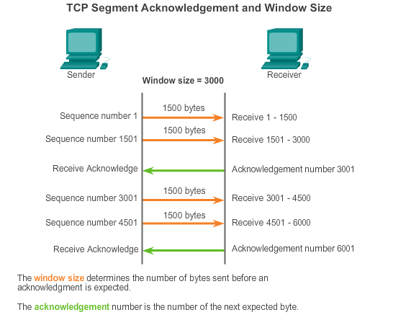
Reliability and Flow Control Window Size and Acknowledgements
Notes:
7.2.2.4 TCP Flow Control- Window Size and Acknowledgements

Slide 30
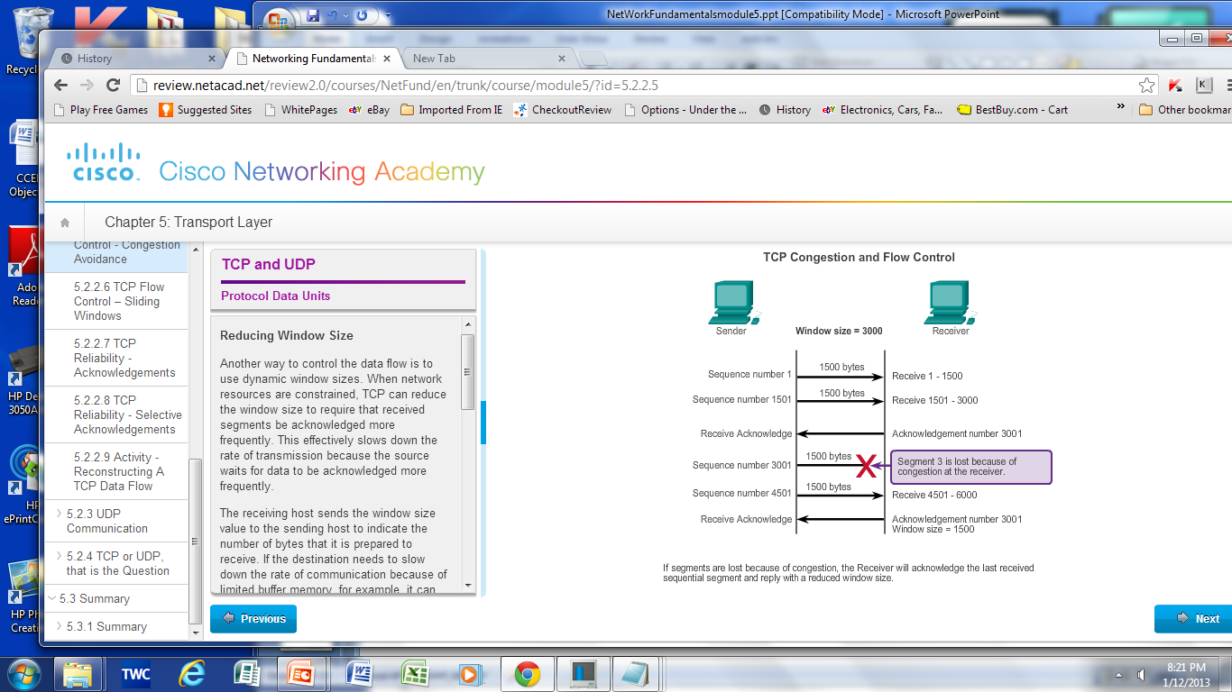
Reliability and Flow Control TCP Flow Control – Congestion Avoidance
Notes:
7.2.2.5 TCP Flow Control –Congestion Avoidance

Slide 31
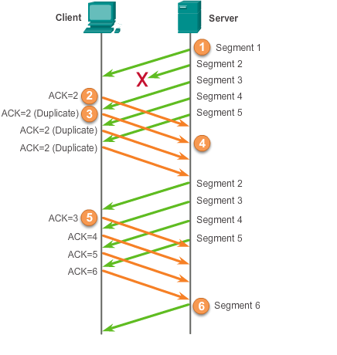
Reliability and Flow Control TCP Reliability - Acknowledgements
Notes:
7.2.2.6 TCP Reliability - Acknowledgements

Slide 32
UDP Communication UDP Low Overhead vs. Reliability
UDP
Simple protocol that provides the basic transport layer function
Used by applications that can tolerate small loss of data
Used by applications that cannot tolerate delay
Used by
DNS
Simple Network Management Protocol (SNMP)
Dynamic Host Configuration Protocol (DHCP)
Trivial File Transfer Protocol (TFTP)
IP telephony or VoIP
Online games
Notes:
7.2.3.1 UDP Low Overhead vs. Reliability

Slide 33
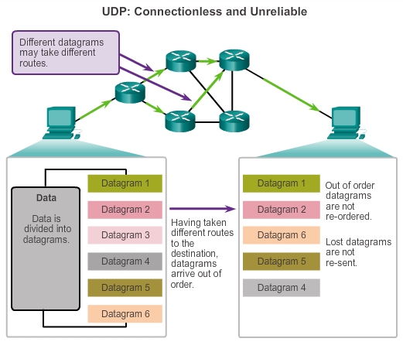
UDP Communication Datagram Reassembly
Notes:
7.2.3.2 Datagram Reassembly

Slide 34
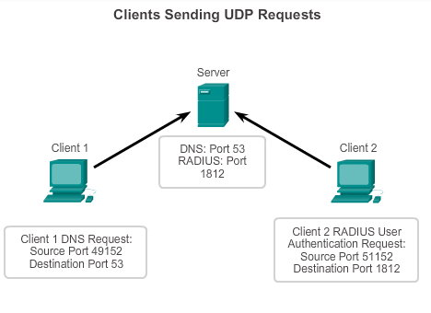
UDP Communication UDP Server and Client Processes
UDP-based server applications are assigned well-known or registered port numbers.
UDP client process randomly selects port number from range of dynamic port numbers as the source port.
Notes:
7.2.3.3 UDP Server Processes and Requests
7.2.3.4 UDP Client Processes

Slide 35
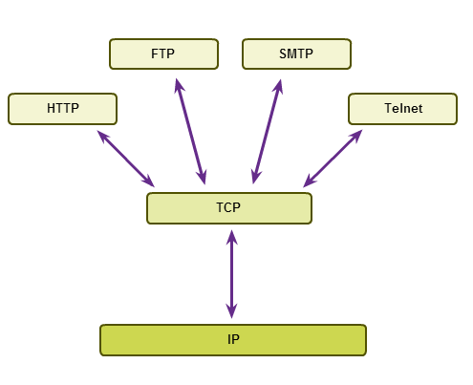
TCP or UDP Applications that use TCP
Notes:
7.2.4.1 Applications that use TCP

Slide 36
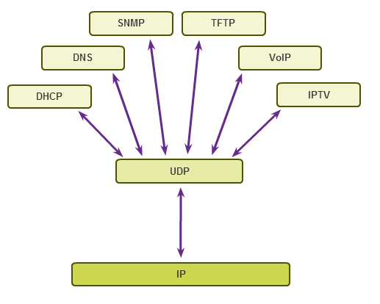
TCP or UDP Applications That Use UDP
Notes:
7.2.4.2 Applications that use UDP

Slide 37
7.3 Summary
Notes:
7.3 Summary

Slide 38
Chapter 7: Summary
In this chapter, you learned:
The role of the transport layer is to provide three main services: multiplexing, segmentation and reassembly, and error checking. It does this by:
Dividing data received from an application into segments.
Adding a header to identify and manage each segment.
Using the header information to reassemble the segments back into application data.
Passing the assembled data to the correct application.
How TCP and UDP operate and which popular applications use each protocol.
Transport Layer functions are necessary to address issues in QoS and security in networks.
Ports provide a “tunnel” for data to get from the transport layer to the appropriate application at the destination.
Notes:
Chapter 7 Summary

Slide 39


